Slide 1

EDP Sprint Reviews & Demos
May 2021

Slide 2

DMS - On Demand
What is DMS On Demand?
A process developed by platform team.
Creates a new replication instance when user needs full load migration.
Replication instance is automatically deleted right after full load migration is complete.
Why DMS On Demand is developed?
As many of the full load and cdc migration tasks using large instance types.
The on demand process deletes the large replication instances once the full load is 100%.
The on demand process make sure that we are not overpaying after full load migration.

Slide 3
DMS - On Demand
Prerequisites:
The source and target endpoints should exist, The endpoints ARN’s are required for this process.
The firewall rules between the source, target and replication instance subnets should be in place.
Future Enhancements:
As of now the replication instance type is hard coded in the CloudFormation template. We are working on parametrizing the instance type.
We are developing process to accommodate the CDC migration type in the on demand process.
Status of the process in a file on s3 bucket where user uploads the YML CloudFormation template.

Slide 4

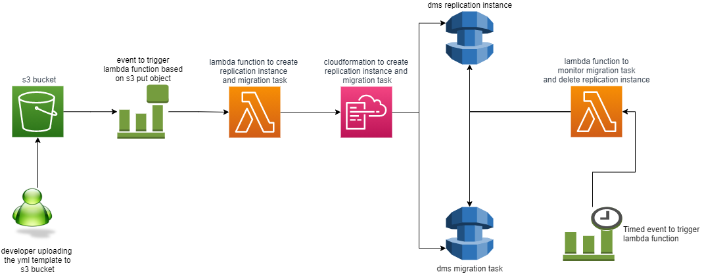
DMS - On Demand resources involved

